Slide 1

Hospitality Analytics

Slide 2
Agenda
How much revenue is generated.
Which hotels perform best.
How efficiently are rooms utilized.
What is the cancellation rate.
Which city contributes the highest revenue.
How do weekdays and weekends perform.
What are the weekly revenue and booking trends.

Slide 3


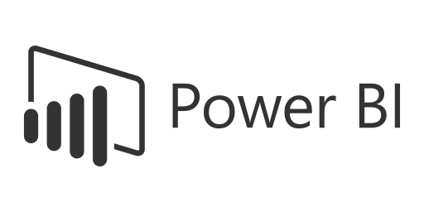
Tools
Excel
Power BI
My SQL
Tableau

Slide 4

Data sate
Booking_date
Check_in_date
Checkout_date
No_guests
Room_category
Room_class
Booking_platform
Ratings_given
Booking_status
Revenue_generated
Revenue_realized
Dim_date.Week no
Dim_hotels.City

Slide 5
Dashboard Overview
Total Revenue
Occupancy
Cancellation Rate
Total Booking
Utilize capacity
Trend Analysis
Weekday & Weekend Revenue and Booking
Revenue by State & hotel
Class Wise Revenue
Checked out cancel No show
Occupancy %
Cancellation Rate
Total Bookings
Total Revenue
₹ 1,708,771,229.00
57.87%
24.83%
134590

Slide 6

Hospital Analysis Project Overview
Hospitality data analytics involves collecting and interpreting information across bookings, operations, and guest feedback to optimize revenue and enhance customer satisfaction.
Maximizing Revenue Per Available Room and Total Revenue Per Available Room by analyzing historical booking data, and competitor rates.

Slide 7
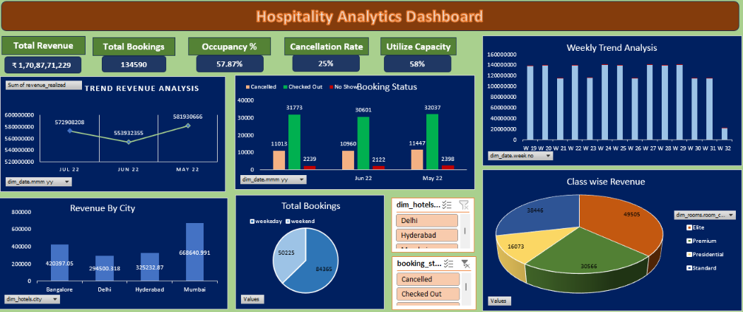
Dashboard

Slide 8
Inside
May is peak booking periods.
The 29-Week is highest revenue July months and weeks.
June slow booking seasons.
Track weekly revenue trends to detect seasonality.
Determine whether weekdays generate more revenue than weekends.
Mumbai is highest revenue generated city and May is highest revenue generated months.
Booking in Luxurious is more in Every City.
Atliq Exotica Hotels with the highest revenue.

Slide 9
Recommendation
Reducing the 24% Cancellation Rate. Introduce advance payment to confirm bookings or flexible cancellation policies where cancellations are highest.
Increase marketing and promotional campaigns in cities that generate the highest revenue.
Expand room inventory or hotel capacity if occupancy is consistently high.
Introduce premium services and room upgrades to increase average revenue per booking.
Analyze the reasons for low revenue, such as low occupancy, high cancellation rates, or limited visibility.

Slide 10

Thank You

